Slide 1
Project 3
Parkinson’s Disease Voice Data
Eric Hansen
Flatiron dS; self paced
12/23/2021

Slide 2
Background
Problem – Parkinson’s Disease affects seven million people globally; voice features are used for diagnosis, but can they be used more effectively?
Stakeholders – Medical professionals, Patients With Parkinson’s (PWP), aging adults
Data – 'Collection and Analysis of a Parkinson Speech Dataset with Multiple Types of Sound Recordings', IEEE Journal of Biomedical and Health Informatics, vol. 17(4), pp. 828-834, 2013. https://archive.ics.uci.edu/ml/datasets/Parkinson+Speech+Dataset+with++Multiple+Types+of+Sound+Recordings#
Model – Eight non-linear classification tools, including logistic regression, k-nearest neighbors, random forest, bagging, gradient boosting and more
Goals
Identify actionable features of voice samples that may predict Parkinson’s to augment existing diagnosis tools
Create optimized model for classification of new voice data

Slide 3
Methodology
1) I performed Exploratory Data Analysis to identify characteristics of the data
2) I created several new features including monotonicity, oral festination, projected gender
3) I created numerous models and optimized their parameters for best recall score (due to priority of avoiding false negatives for PD) across crossvalidation
4) I tested each of these models on the test set
5) I identified a model which scored highly on the training and test set and extracted meaningful important features
6) I created a pipeline and pickled it for portability and ease of future use
7) The conclusions: random forest model had a high recall score; it assigned high feature importance to some jitter and pitch features
Furthermore, the model is ready to accept any new voice data, to aid in diagnosis

Slide 4


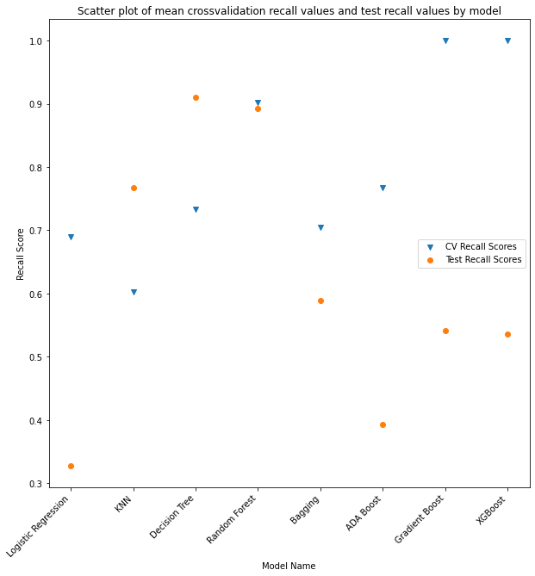
Results 1 – CrossValidation Recall vs Model
Multiple crossvalidation rounds were taken for each model, average recall was computed across these rounds
Recall was also computed for each model on the test set (which is 100% patients with Parkinson’s)
Some models had significantly different trainCV/test recall
One model which did well on both was Random Forest, which had recall scores of 90% and 89%
Other models and scores are:
logistic regression: 69%, 33%
knn: 60%, 77%
decision tree: 73%, 91%
bagging: 70%, 59%
adaboost: 77%, 39%
gradientboost: 100%, 54%
xgboost: 100%, 54%

Slide 5
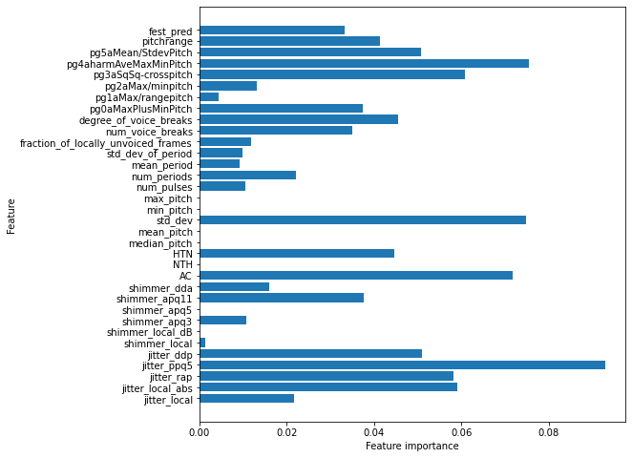
Results 2 – Feature Importances for Random Forest model
The top 10 features of highest importance are:
Jitter_ppq5
pg4aharmAveMaxMinPitch
Std_dev (of pitch)
AC (autocorrelation)
pg3aSqSq-crosspitch
Jitter_local_abs
Jitter_rap
Jitter_ddp
pg5aMean/StddevPitch
Degree of voice breaks
Festination and Pitch Range were in the next six

Slide 6
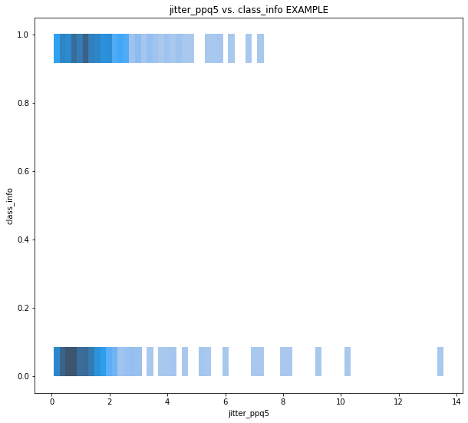
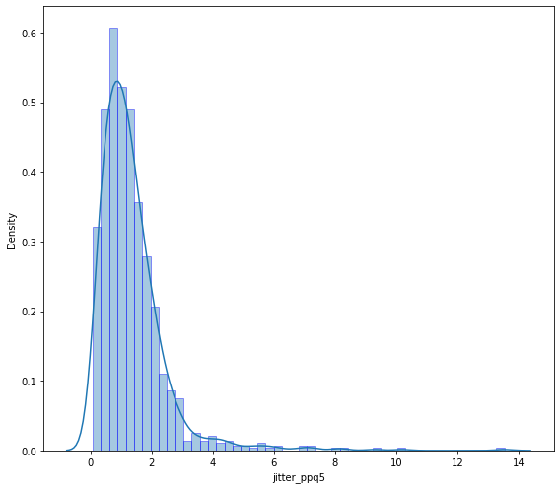
Jitter_ppq5 Further inspection
It is challenging to visually identify relationships between a numeric predictor and a binary target variable, as seen in the top graph.
Jitter_ppq5 didn’t have any distinctive features in its distribution function

Slide 7
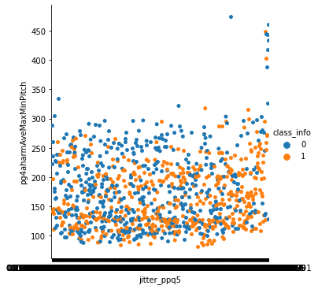
Jitter_ppq5 – including pg4a
If we try to separate behavior by not just one predictor, but two, and color code by target variable, we can get a little visual insight.

Slide 8

Conclusions/questions
A random forest model has identified some characteristics to dial in on.
As stated earlier, the top 5 features are Jitter_ppq5, pg4aharmAveMaxMinPitch, Std_dev (of pitch), AC (autocorrelation), pg3aSqSq-crosspitch
This model had a mean recall score over cross-validation of 90%. It had recall score on the test set of 89%.
Actionable items:
Prioritize identifying speech pathologies that correspond to jitter_ppq5, harmonic average of max and min pitch, pitch standard deviation, and autocorrelation
Use random forests or other model to add layer of additional screening to PD evaluations.
Potential further steps:
acquire more labeled data to further train models.
Perform study over time to identify early-changing features that predict eventual PD.
Questions?

